Slide 1
Normal Forms, Tautology and Satisfiability

Slide 2
DeMorgan’s Laws
¬(p∨q) ≡(¬p∧￢q) “nor”
driving in negations flips ands to ors
¬(p∧q) ≡(¬p∨￢q) “nand”
Driving in negations flips ors to ands
Also law of double negation: ¬¬p ≡p
By repeatedly replacing LHS by RHS all negation signs can be pressed against variables
￢(p∨(q∧r)) ≡￢p∧￢(q∧r) ≡￢p∧(￢q∨￢r)

Slide 3
DeMorgan’s Laws
A literal is a propositional variable or the negation of a propositional variable
So: Every formula is equivalent to one made up using only ∨, ∧, and literals
But even more “standardization” is possible

Slide 4
Distributive Laws, Normal Forms
p∧(q∨r)≡(p∧q)∨(p∧r)
p∨(q∧r)≡(p∨q)∧(p∨r)
By applying these transformations, every formula can be put in either
Conjunctive normal form (and-of-ors-of-literals), or
Disjunctive normal form (or-of-ands-of-literals)
￢p∨ (￢q∧￢r) is in DNF
(￢p∨￢q)∧(￢p∨￢r) is an equivalent CNF

Slide 5
Tautology
A tautology is a formula that is true under all possible truth assignments
p | q | ￢(p∧q) ≡ (¬p∨￢q)
T | T | T
T | F | T
F | T | T
F | F | T

Slide 6
Satisfiability
A satisfiable formula is one that is true for at least one truth assignment
A formula is unsatisfiable (last column all F) iff its negation is a tautology (last column all T)
p | q | ￢p∧q
T | T | F
T | F | F
F | T | T
F | F | F

Slide 7
P = NP?
One can in principle always determine whether a formula is satisfiable, unsatisfiable, a tautology by filling in the truth table and looking at the last column.
Checking each line is easy, but the table for a formula with n variables has 2^{n} rows.
n = 100 => 2^{n} >> # of particles in the universe
2^{n} nanoseconds >> age of the universe
Is there a faster way than exhaustive search?
Is there a sub-exponential algorithm?

Slide 8
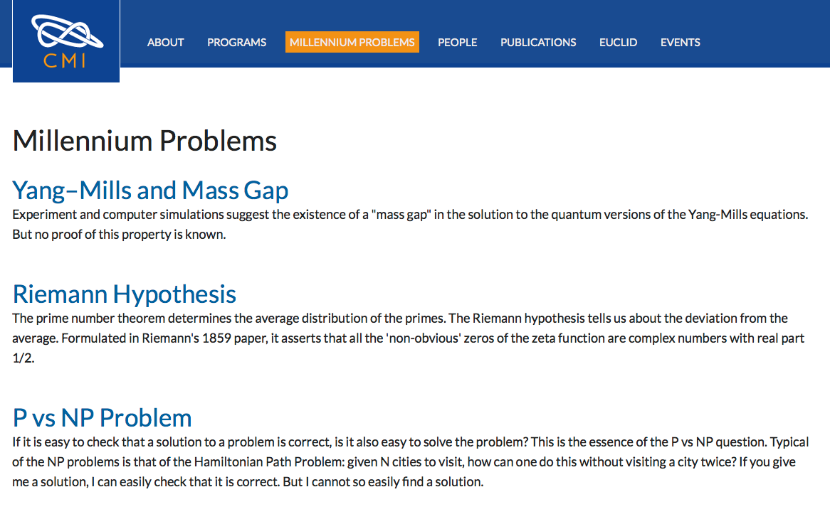
FINIS

